Slide 1
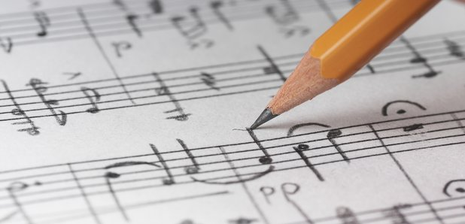
Music Theory Lesson 2
By Free Knowledge Mission

Slide 2
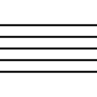
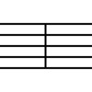
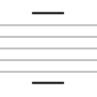
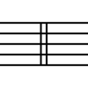
(
A
B
C
D

Slide 3
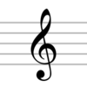
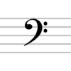
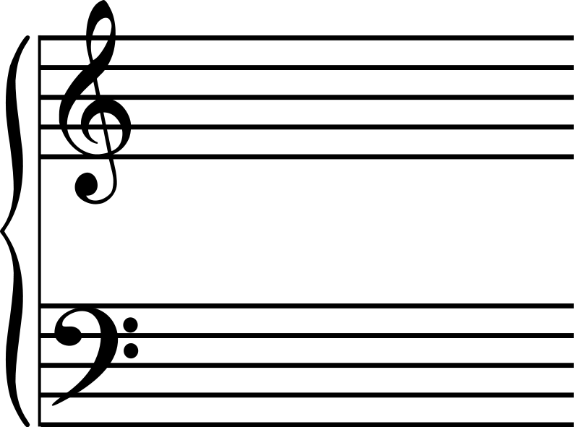
C
The

Slide 4
Key
The

Slide 5
Time Signatures
Top

Slide 6

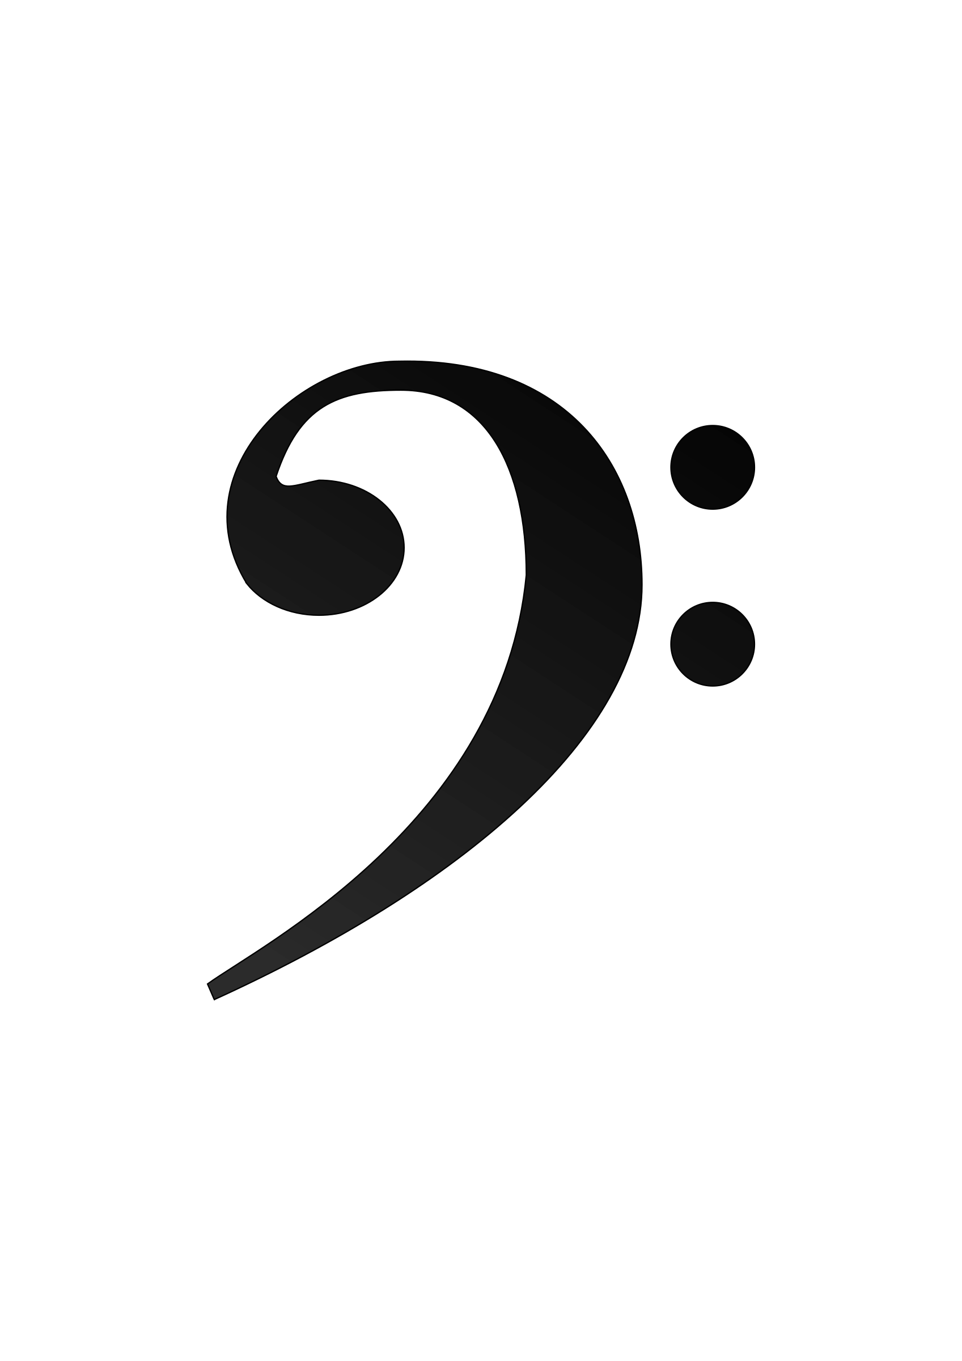
Note Names
The musical alphabet uses the letters A-G. The lines and spaces of the Treble Clef and the Bass Clef are spelled differently.
Treble Clef from the bottom up
Every Good Boy Deserves Fudge
The spaces spell the word FACE
Bass Clef from the bottom up
Green Birds Don’t Fly Away
All Cows Eat Grass
E
C
A
F
G
D
G
E
E
C
A
F
D
C
B
A
F
D
B
G
G
E
C
A
E
C
A

Slide 7






Note Values & Stem Direction
Whole, half, quarter, eight, sixteenth, thirty second

Slide 8

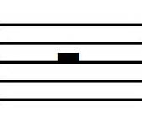


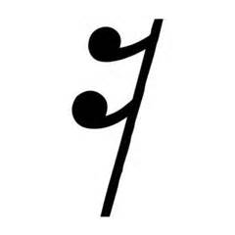
Rests
Whole
Half
Quarter
Eighth
Sixteenth

Slide 9
Practice for a week
Staff

Slide 10
Upcoming Schedule & Brainstorm New Topics
Share

Slide 11
Resources
Lypur – Andrew Furmanczyk
Notes and Slides

